Slide 1

Comprehensive Profiling of Gut Microbiome Modulation in Response to Polycyclic Aromatic Hydrocarbon Exposure
Keji Adedayo
RESEARCH METHODS II
May 6th, 2025

Slide 2
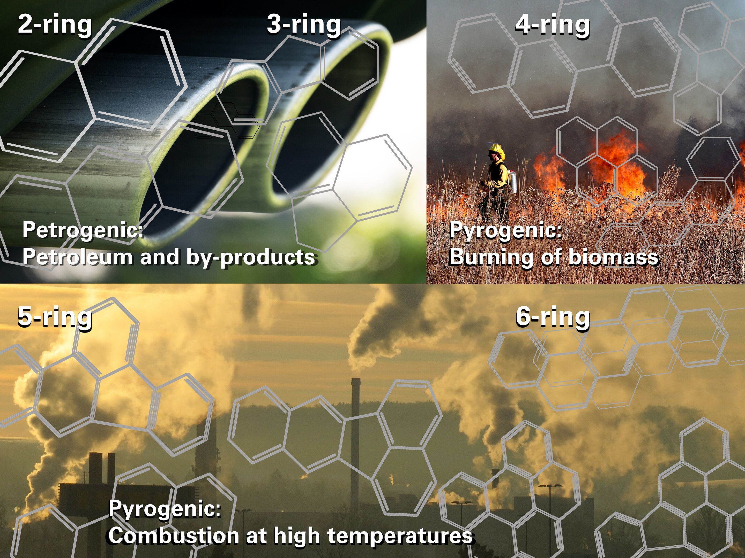
PAHs and the Gut Microbiome
Environmental pollutants
Ubiquitous exposure
Severe health impacts
University of Johannesburg, phys.org, March 22, 2021
Notes:
Incomplete burning of organic matter (e.g., fossil fuels, tobacco smoke, charred foods)
Ubiquitous exposure- soil, water, air, food, occupational hazard
Severe health impacts- linked to immune dysregulation, metabolic diseases, and cancer risk

Slide 3
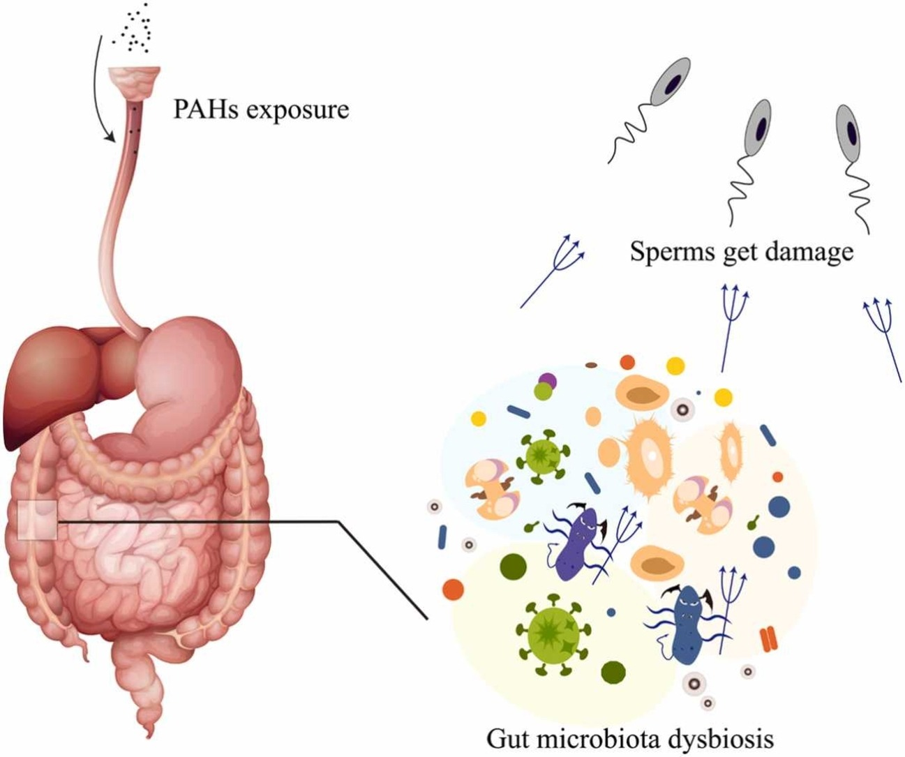
PAHs and the Gut Microbiome
PAHs exposure
Gut microbiota dysbiosis
University of Johannesburg, phys.org, March 22, 2021; Li et al, Ecotoxicol Environ Saf, 2024
Notes:
Compositional and functional dysbiosis of the gut microbiome- imbalance in microbial composition, lipid metabolism and disruption of metabolic pathways related to detoxification

Slide 4
Analysis Overview
How is the gut microbiome composition affected by exposure to PAHs?
What is the difference between modulations to the gut microbiome in response to acute and sub-chronic exposure to PAHs?
Control Acute
Analysis Plan:
Microbial diversity analysis
Differential abundance testing
Machine learning
Made up 16S rRNA seq data
Control SubChronic
Dose Acute
Dose SubChronic
Notes:
Guiding Questions: basic and applied side (How can we …)

Slide 5
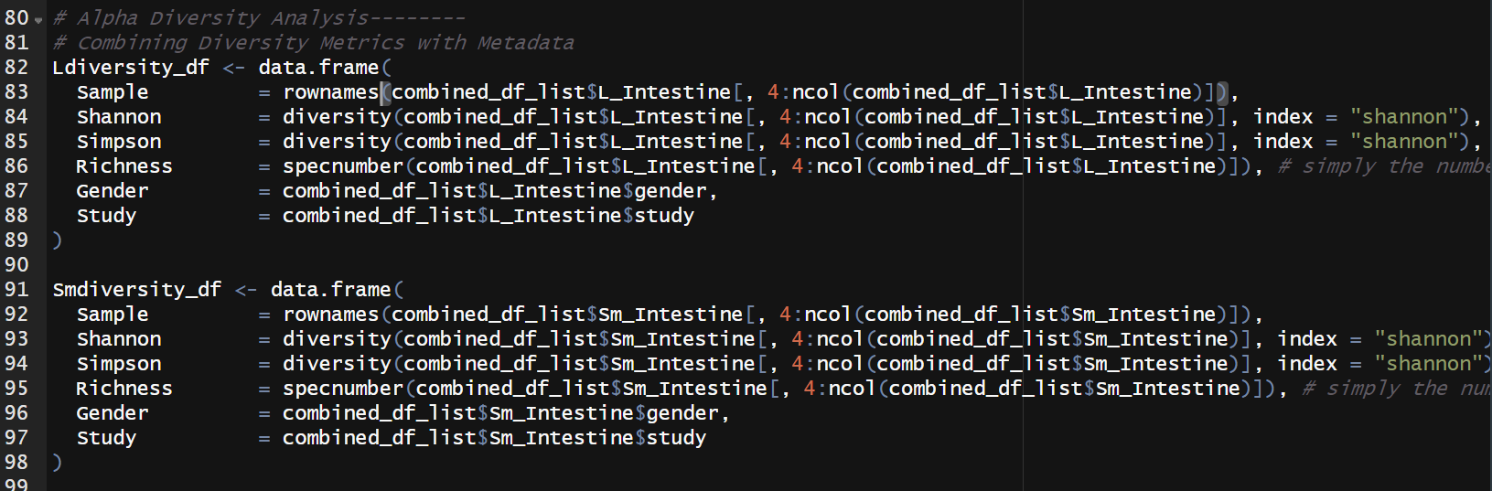
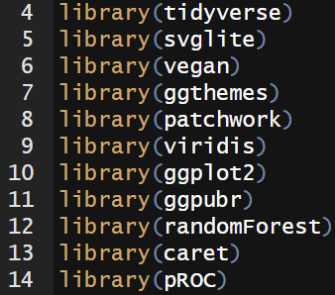
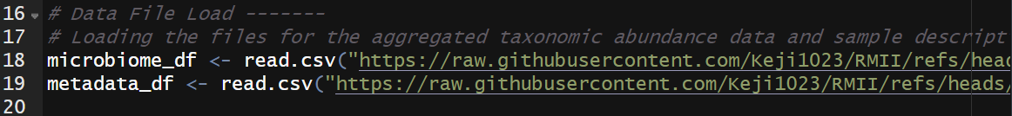
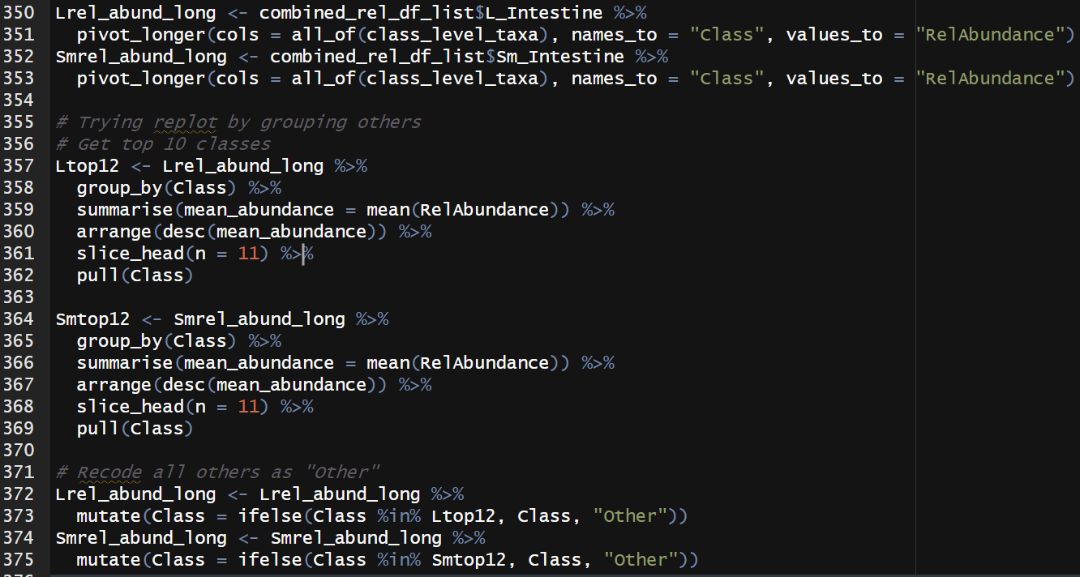
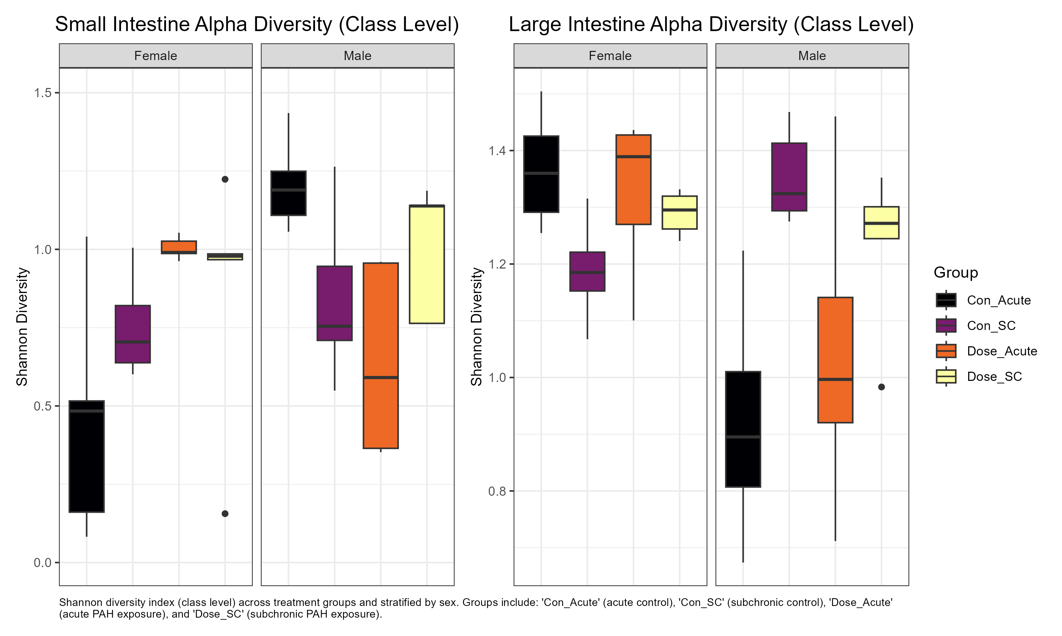
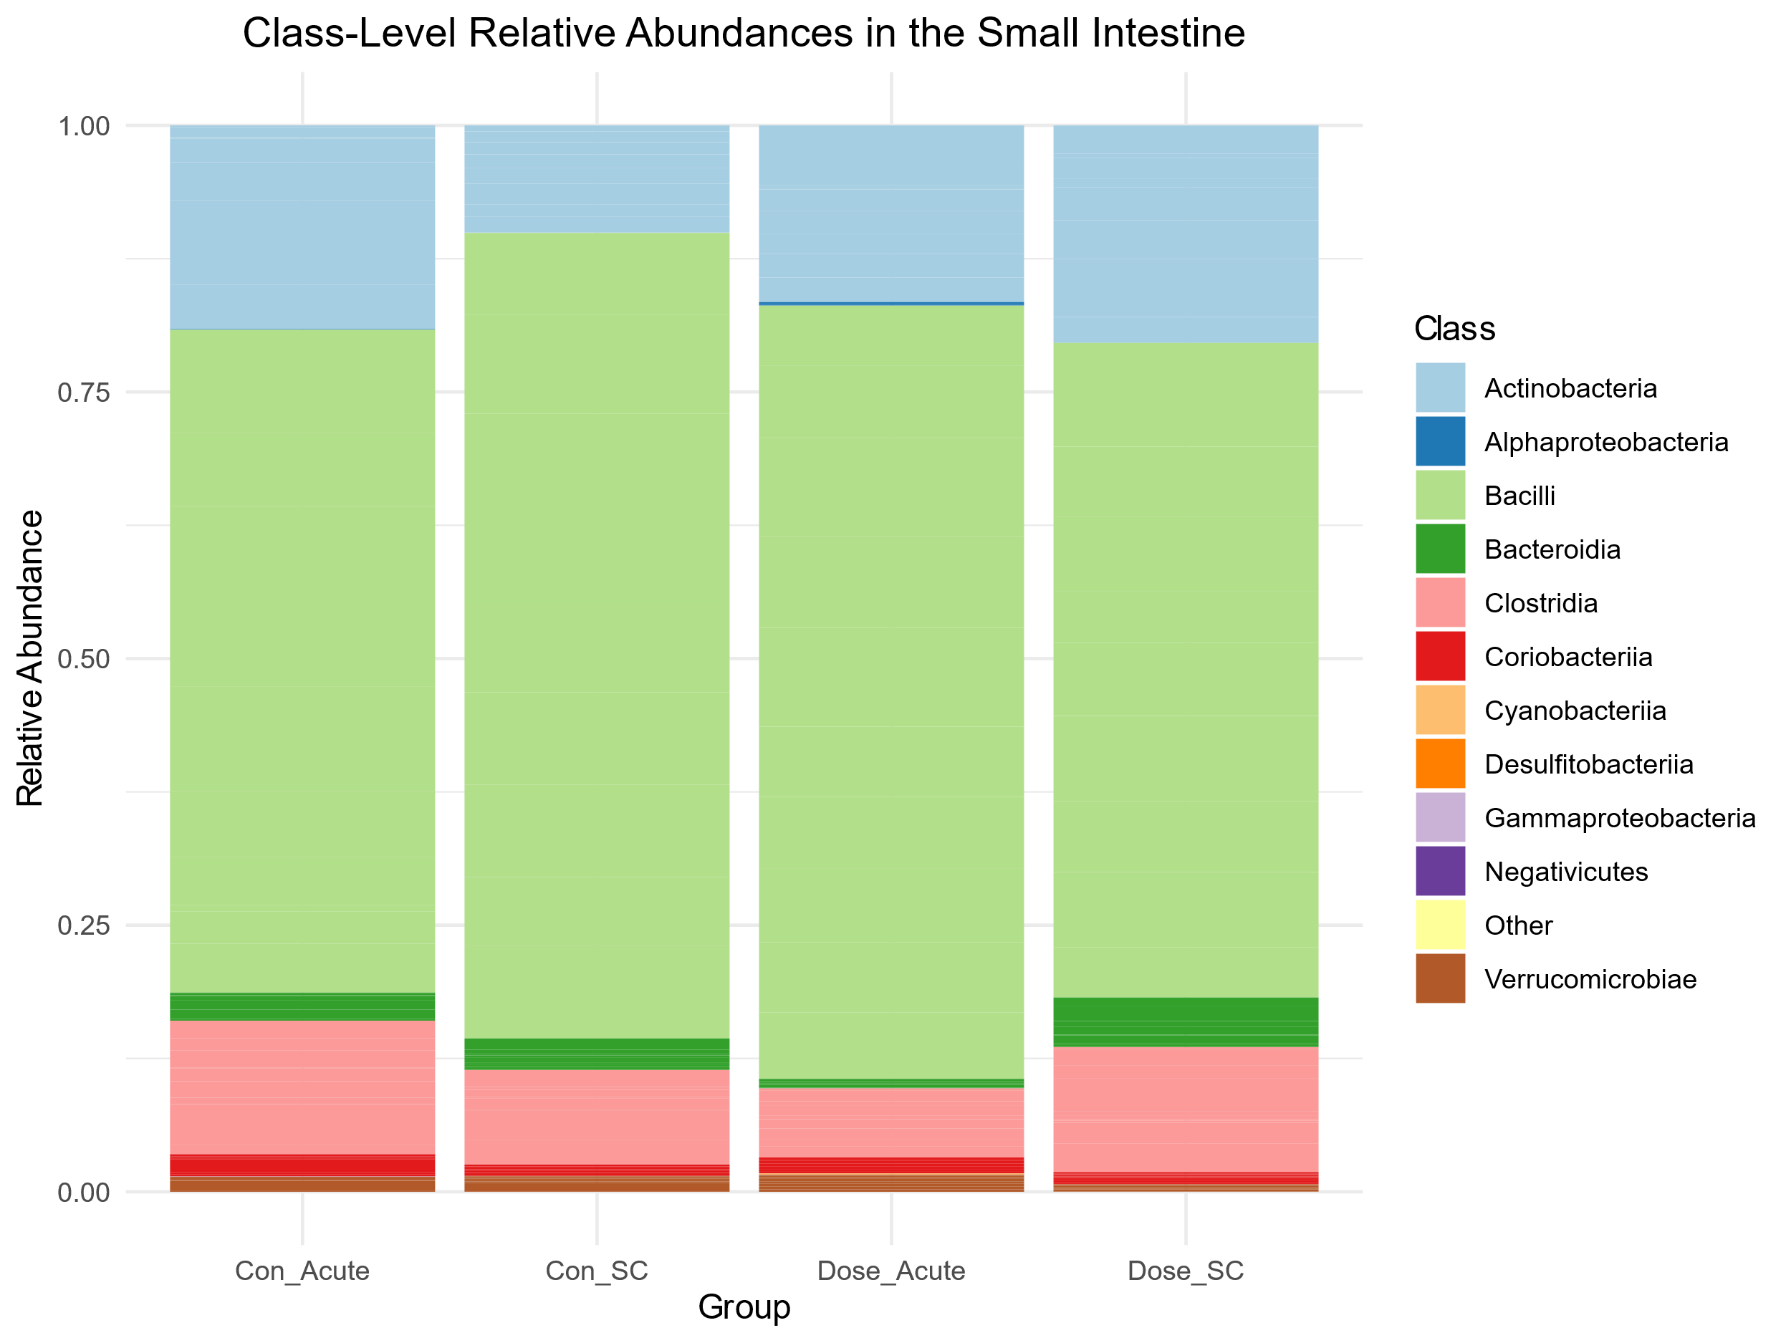
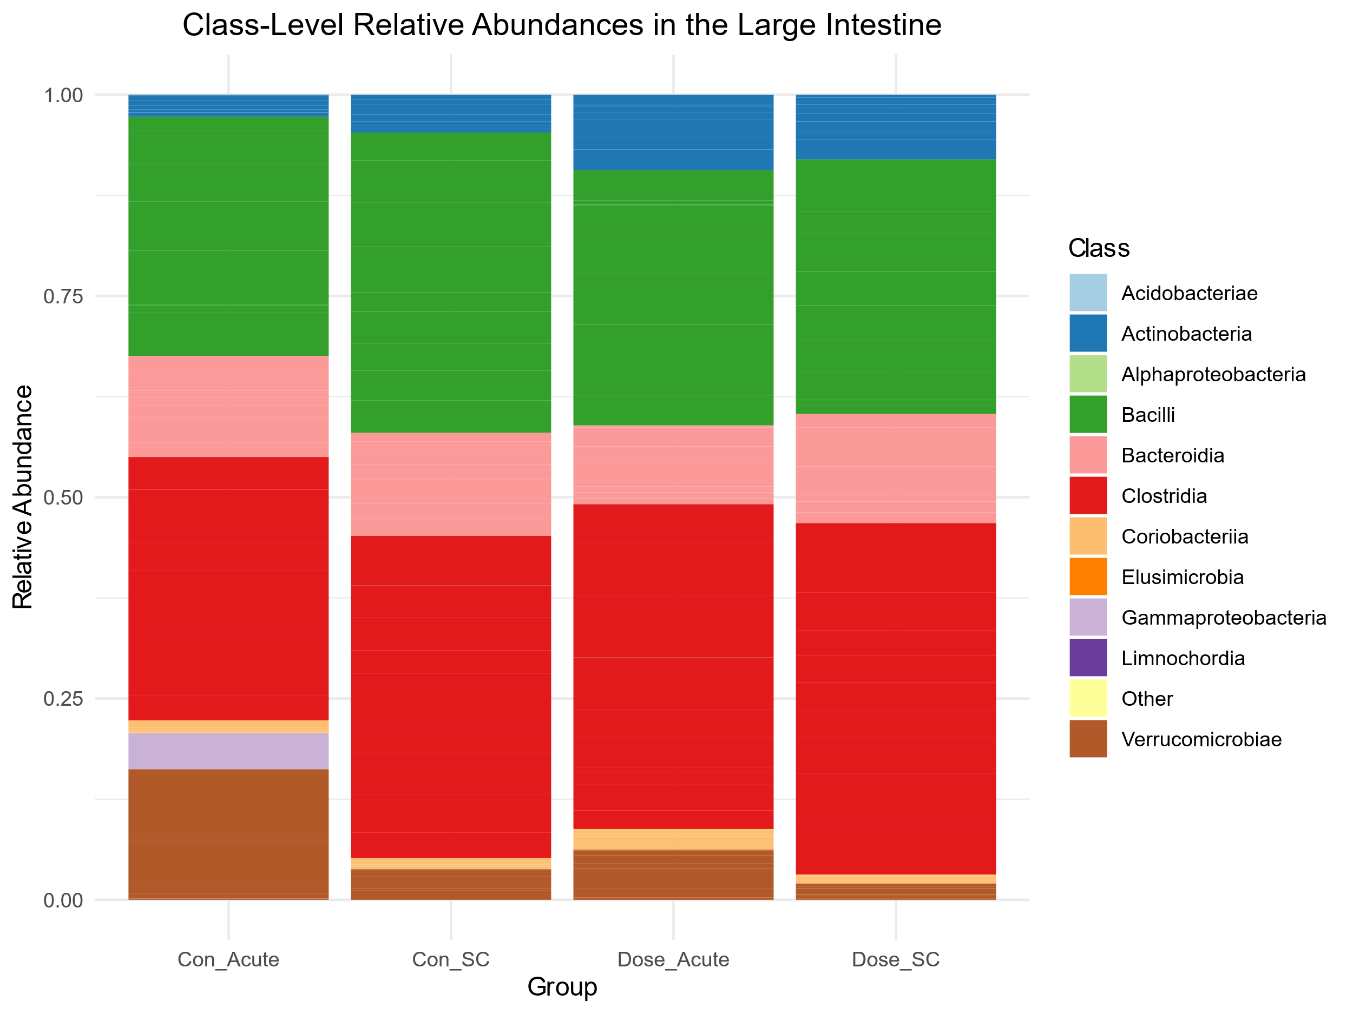
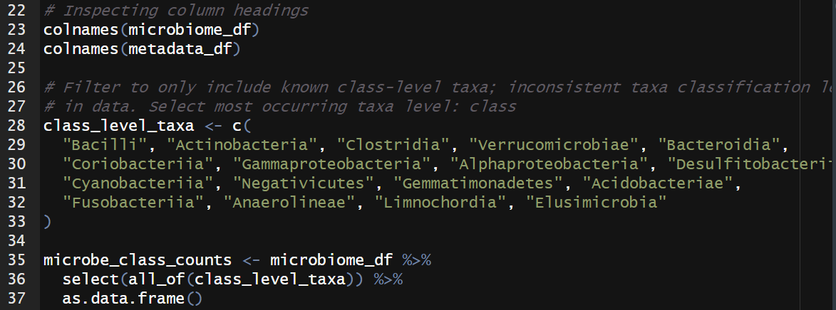
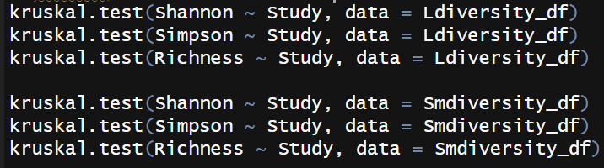
Results Part 1
Notes:
About Data source, what code does
Relative abundance
Alpha diversity

Slide 6
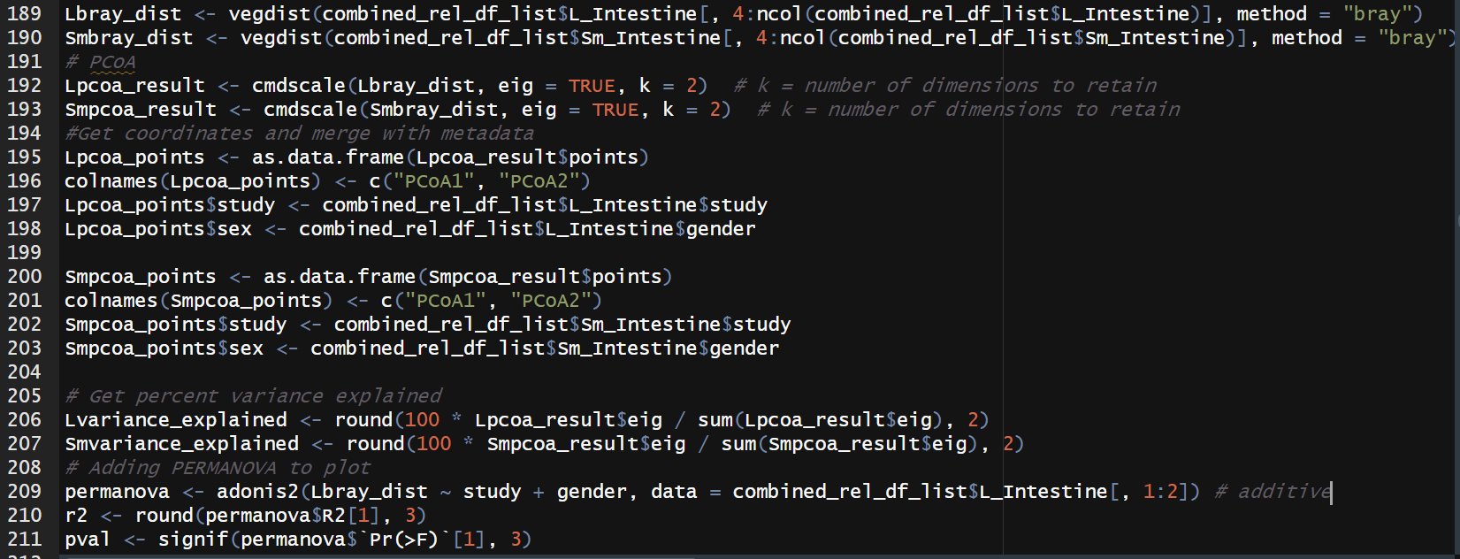
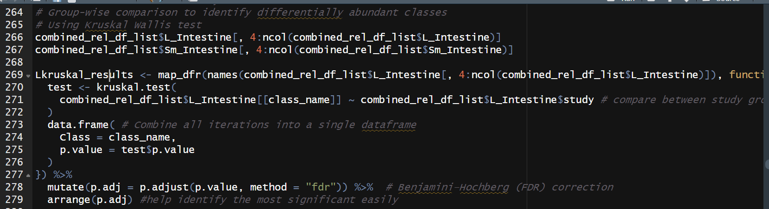
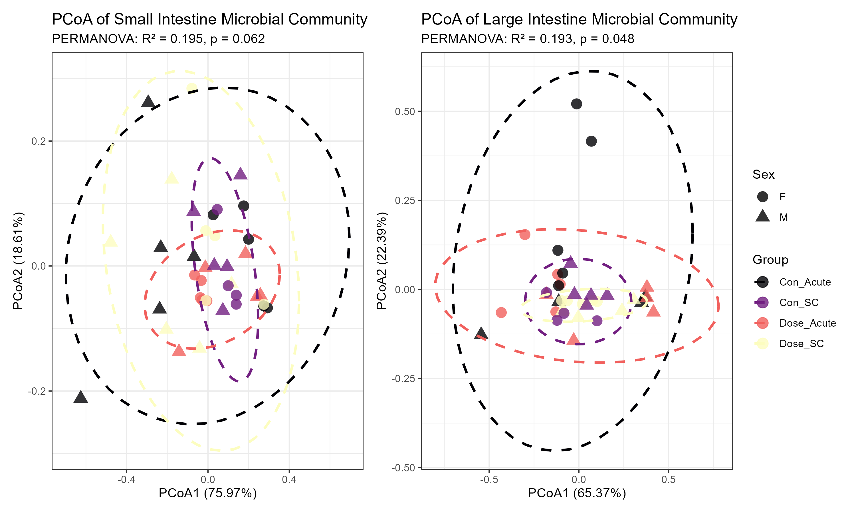
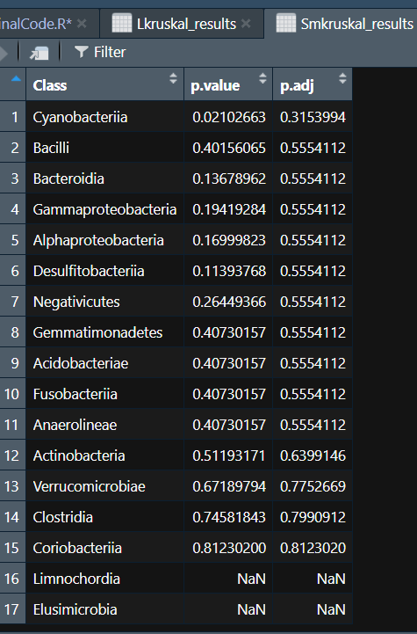
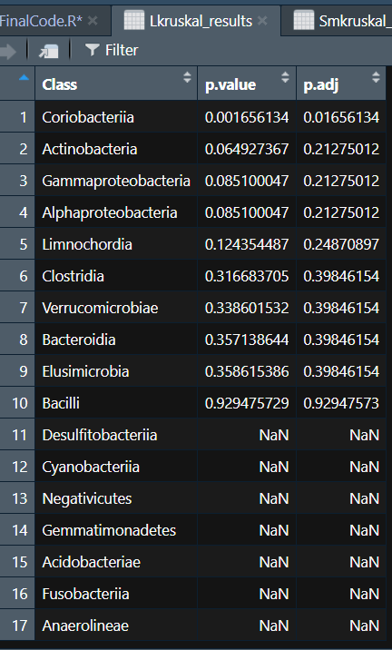
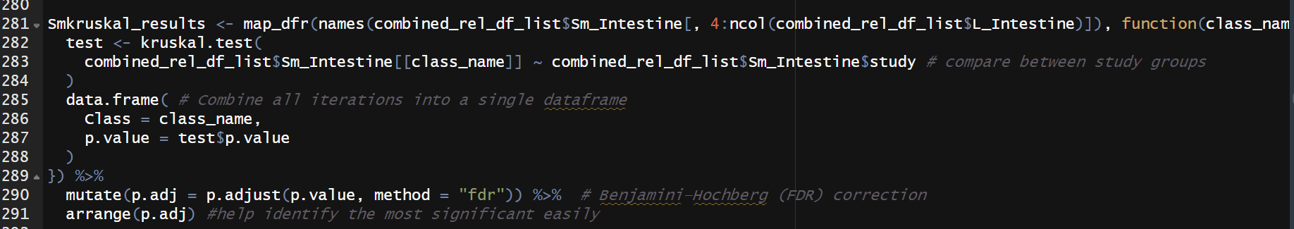
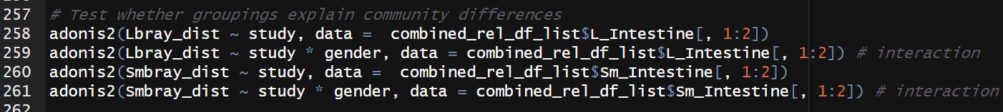
Results Part 2
Notes:
Beta diversity
Significance of results: Significant interaction effect between treatment and sex in large intestine and small intestine.
Top differentially abundant taxa: Coriobacteriia is the only significantly differentially abundant taxa in the large intestine.

Slide 7
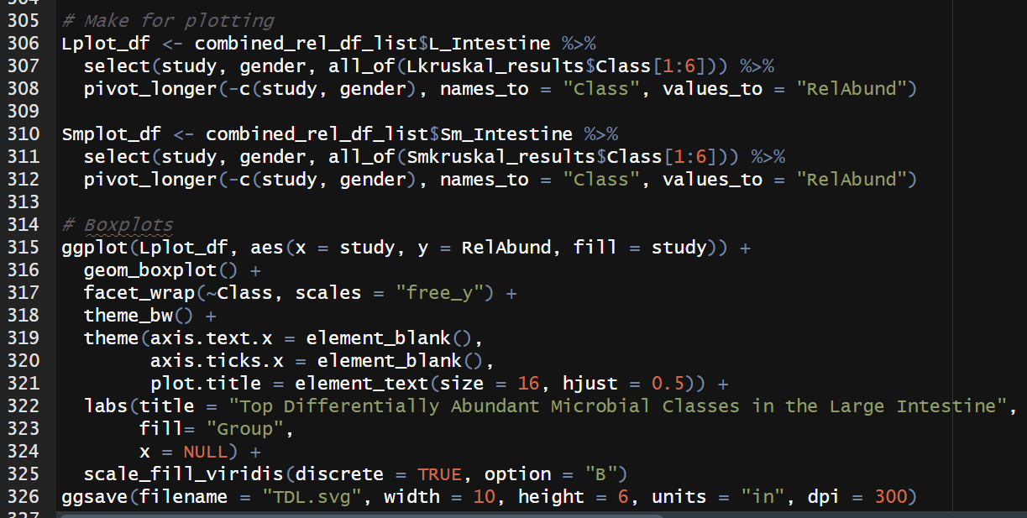
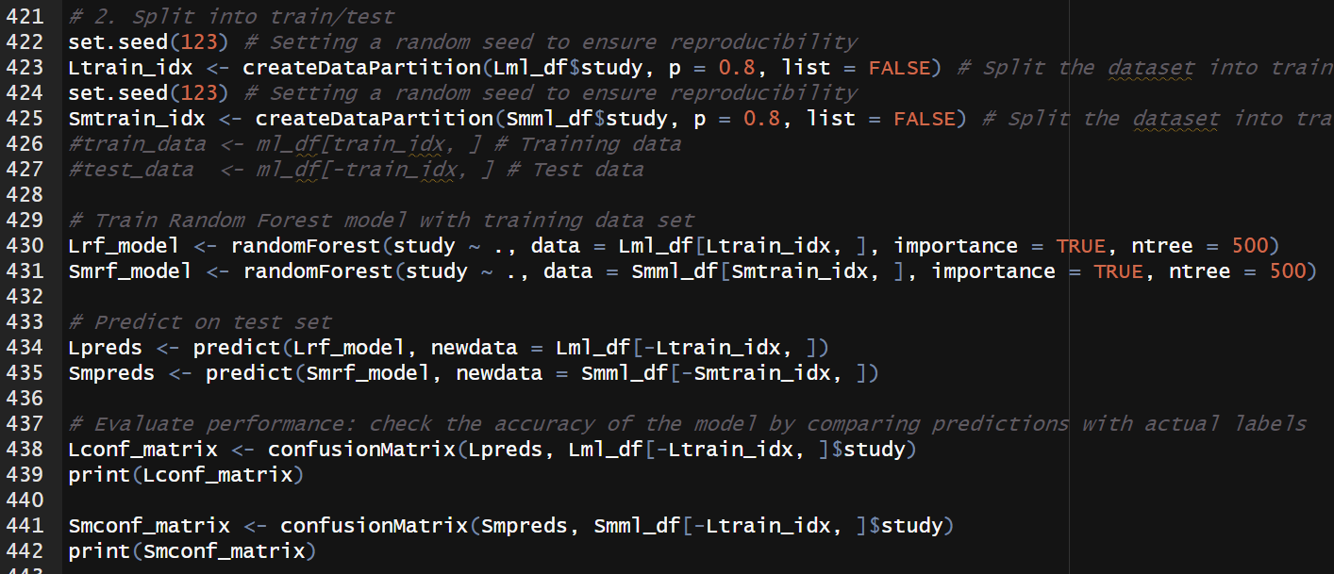
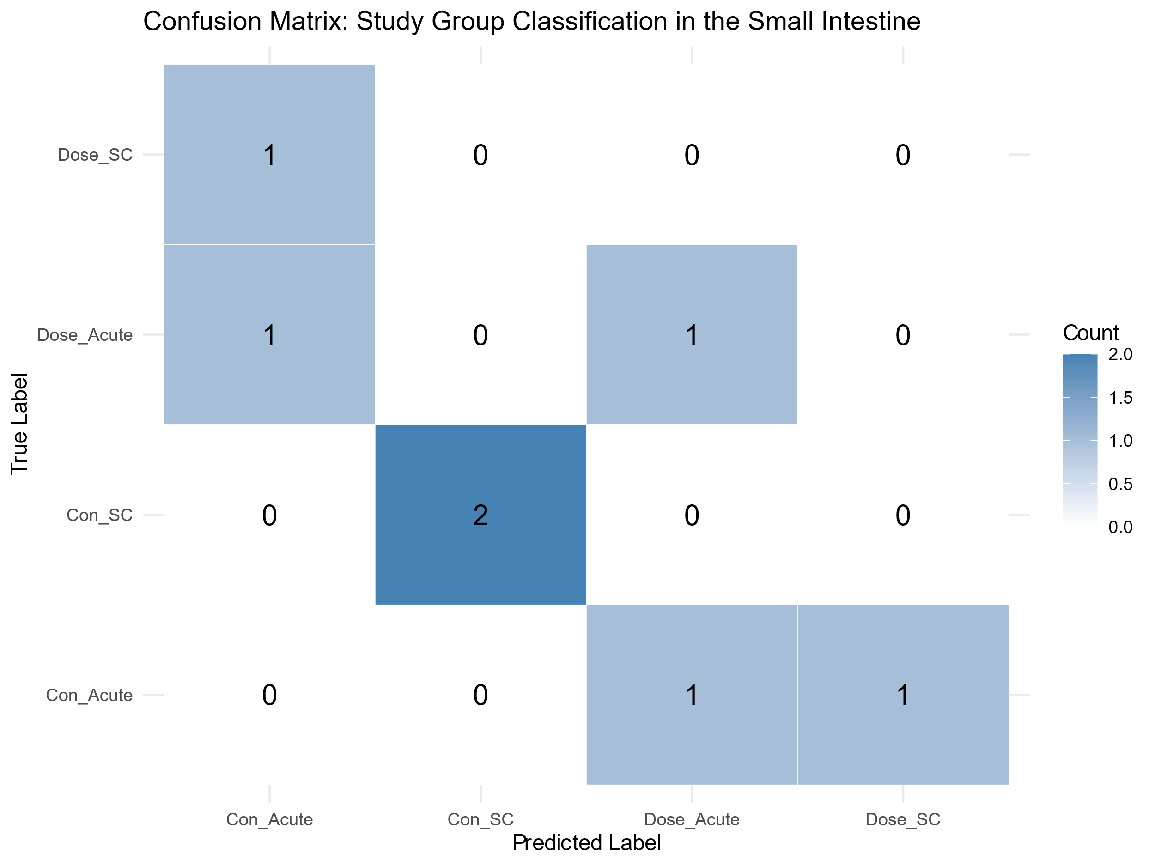
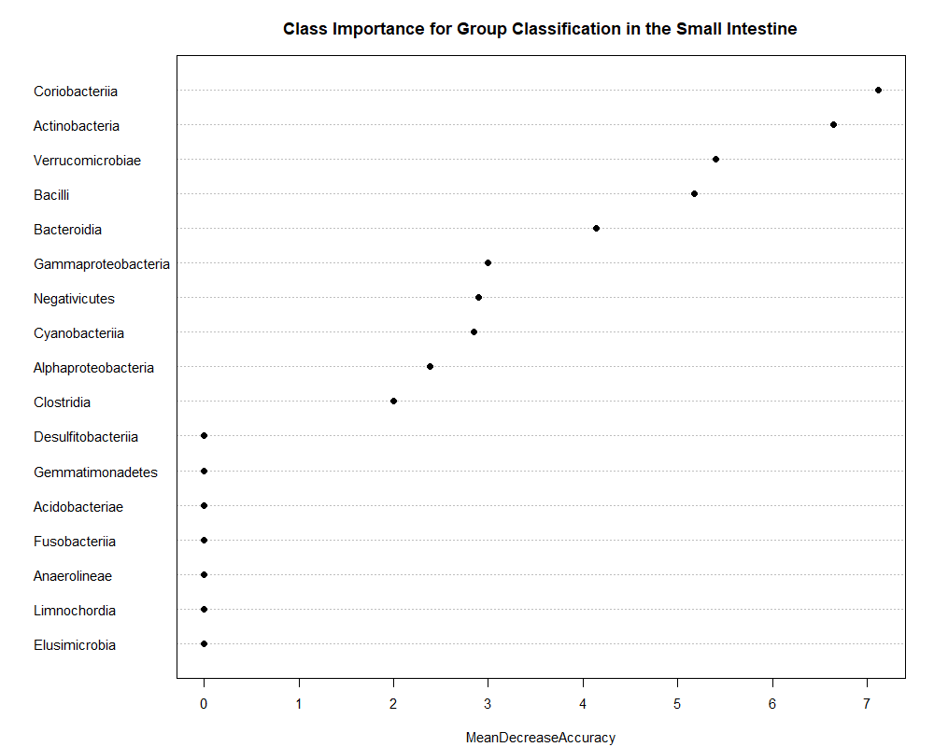
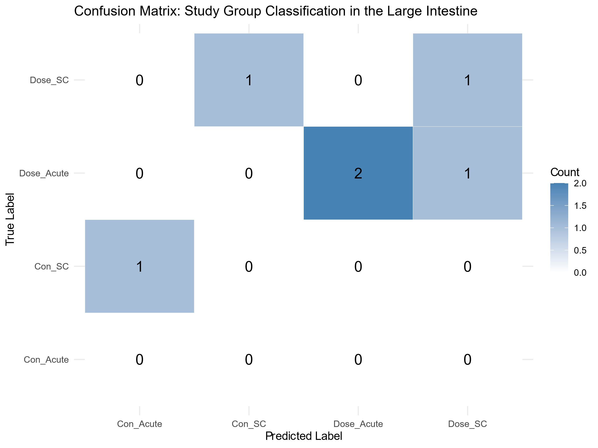
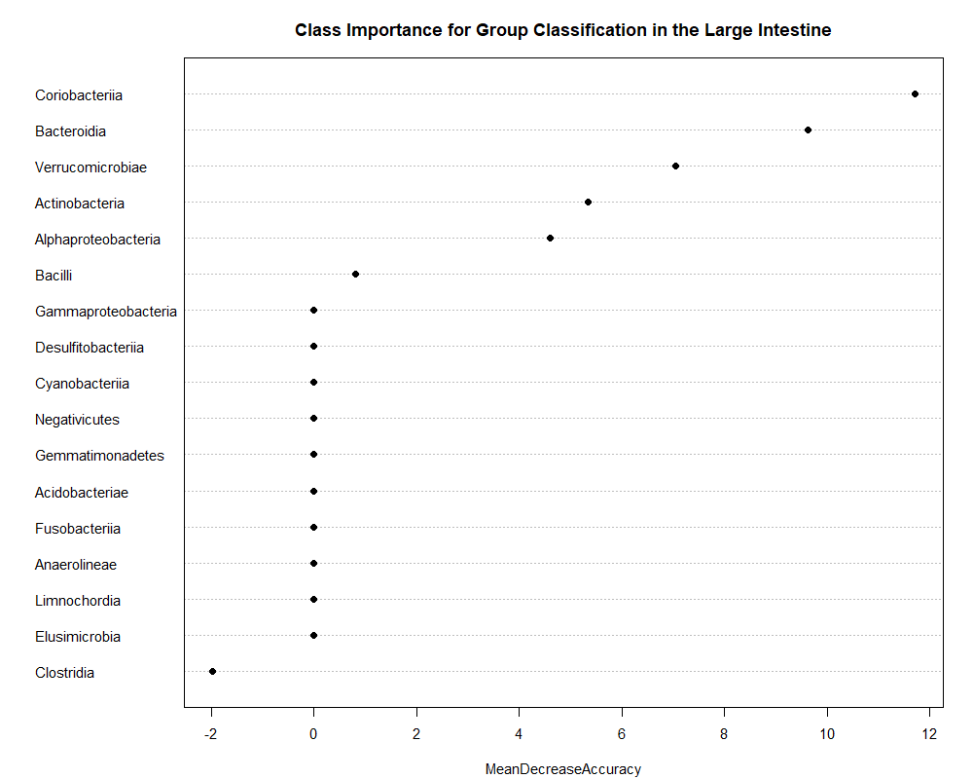
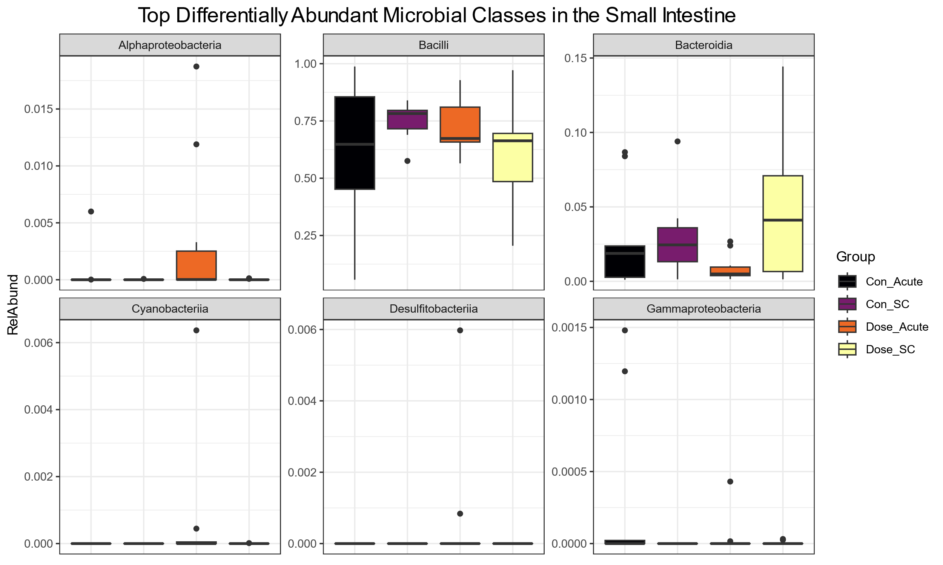
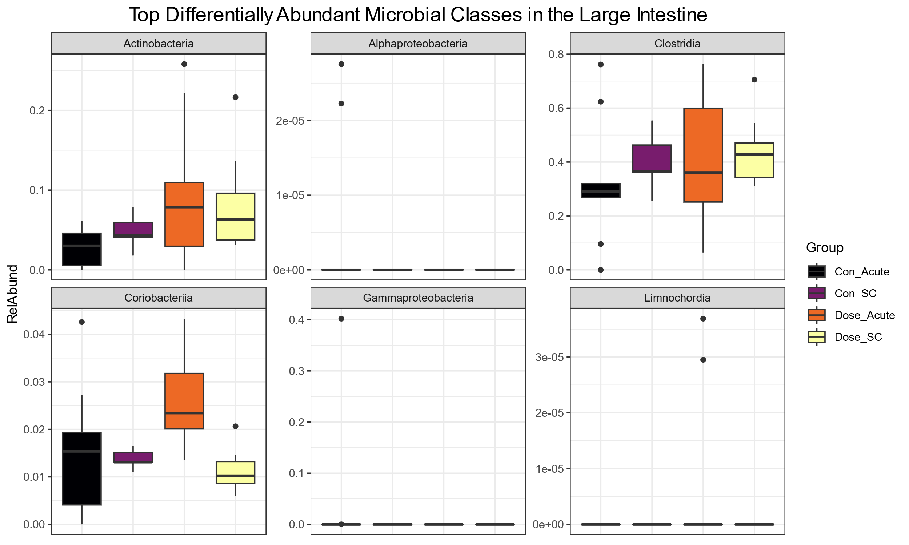
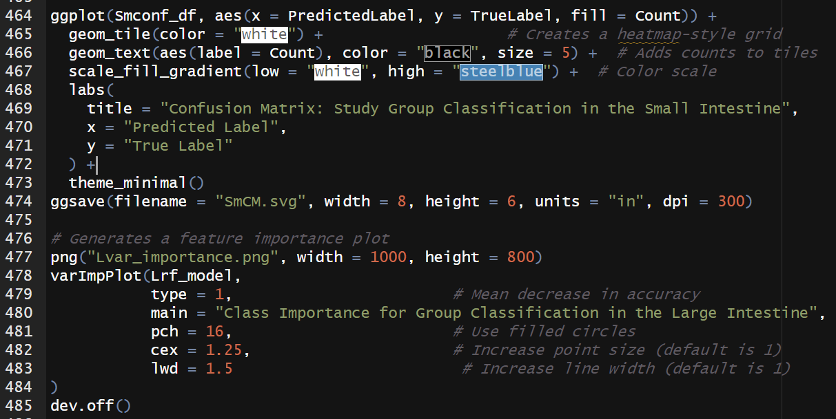
Results Part 3
Notes:
Top differentially abundant taxa: Coriobacteriia is the only significantly differentially abundant taxa in the large intestine.
Confusion Matrix
Important features contributing to the prediction model

Slide 8
Conclusion
Take Home Message:
Non-significant results
Better data cleaning measures
Complete R script for microbiome analysis using 16S rRNA Seq data
Next Steps:
Analyze published data using R script
Learn more about predictive modeling
Data pre-processing: QIIME2, DADA2
Notes:
Conclusion, future applications
Start with phyloseq

